Slide 1
MSA 프로젝트에서 Kafka 도입하기

Slide 2
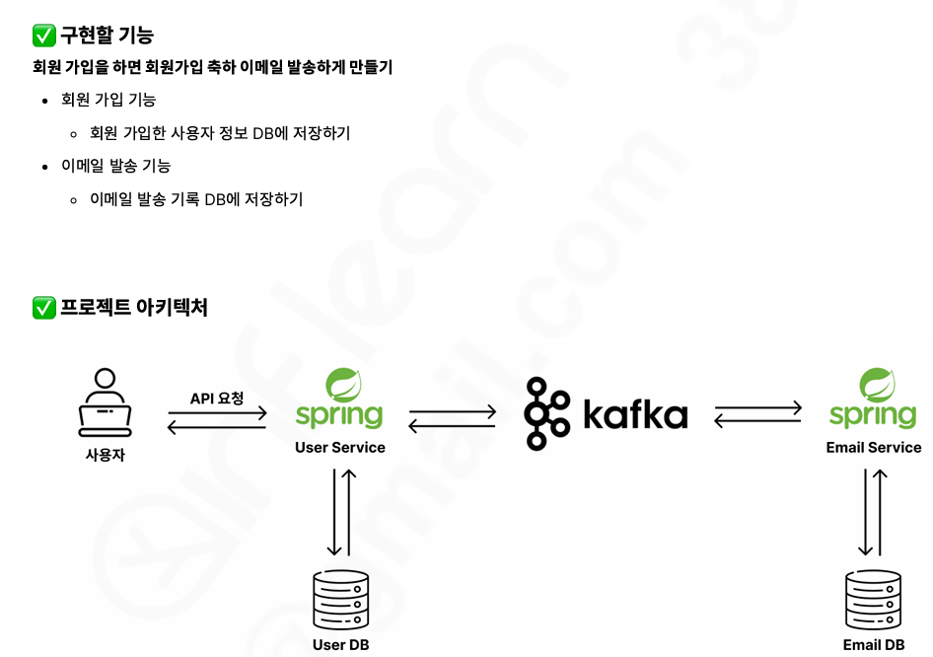
실습 프로젝트 개요

Slide 3
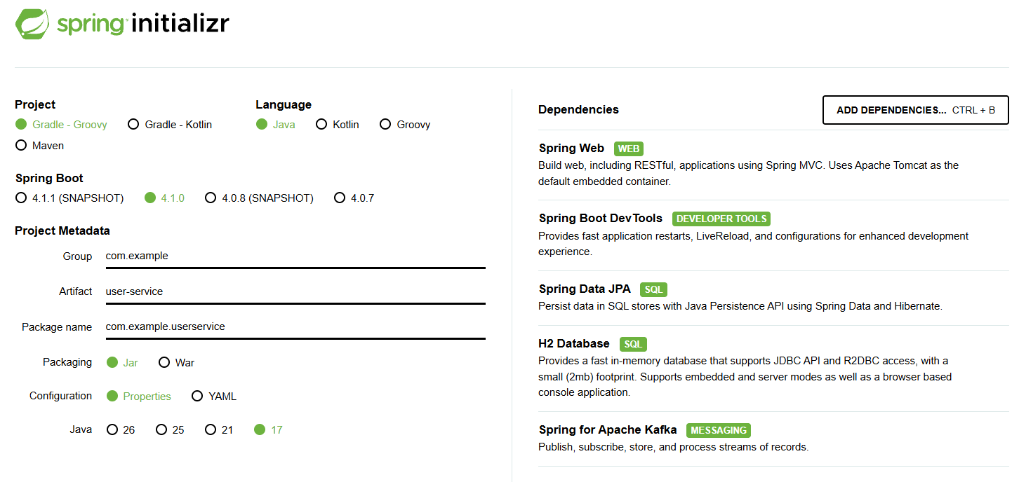
user-service 추가하기

Slide 4
application.yml 작성
server:
port: 8080
spring:
kafka:
bootstrap-servers:
- 3.34.90.182:9092
- 3.34.90.182:19092
- 3.34.90.182:29092
producer:
key-serializer: org.apache.kafka.common.serialization.StringSerializer
value-serializer: org.apache.kafka.common.serialization.StringSerializer
properties:
partitioner.class: org.apache.kafka.clients.producer.RoundRobinPartitioner
h2:
console:
enabled: true
datasource:
url: jdbc:h2:mem:userDB
driverClassName: org.h2.Driver
username: sa
password:

Slide 5
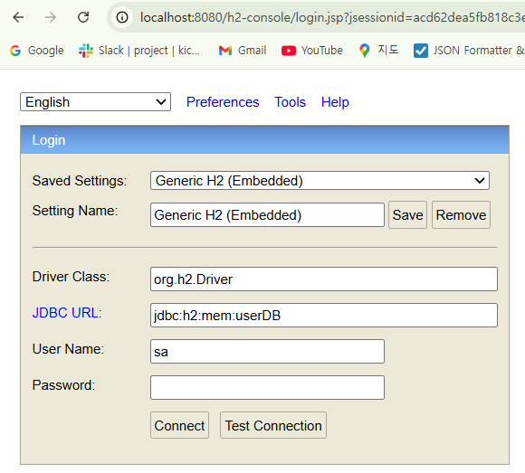
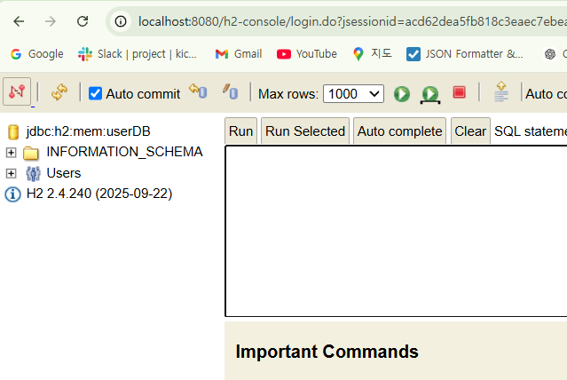
h2-console 접속

Slide 6
User Entity 작성
@Entity
public class User {
@Id @GeneratedValue(strategy = GenerationType.IDENTITY)
private Long id;
private String email;
public Long getId() {
return id;
}
public String getEmail() {
return email;
}
public String getName() {
return name;
}
public String getPassword() {
return password;
}
private String name;
private String password;
public User(){
}
public User(String email, String name, String password) {
this.email = email;
this.name = name;
this.password = password;
}
}

Slide 7
SignedUpRequestDto 작성
public class SignUpRequestDto {
private String email;
private String name;
private String password;
public SignUpRequestDto() {}
public SignUpRequestDto(String email, String name, String password) {
this.email = email;
this.name = name;
this.password = password;
}
public String getEmail() {
return email;
}
public String getName() {
return name;
}
public String getPassword() {
return password;
}
}
front-end 로 부터 요청을 받아올 DTO 작성

Slide 8
UserSignedUpEvent
public class UserSignedUpEvent {
private Long userId;
private String email;
private String name;
public UserSignedUpEvent(Long userId, String email, String name) {
this.userId = userId;
this.email = email;
this.name = name;
}
public UserSignedUpEvent() {}
public Long getUserId() {
return userId;
}
public String getEmail() {
return email;
}
public String getName() {
return name;
}
}
kafka 메세지에 담을 객체(DTO) 작성

Slide 9
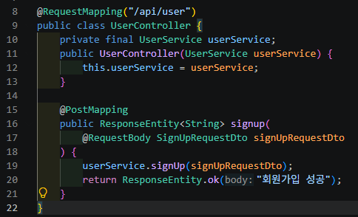
UserController 작성
SignUpRequestDto 를 받아 회원가입 서비스에 전달한다.
회원가입이 성공하면 "회원가입 성공" 메세지를 반환한다.
@RestContoller 빼먹음 (추가)

Slide 10
UserService 작성
@Service
public class UserService {
private final UserRepository userRepository;
private final KafkaTemplate<String, String> kafkaTemplate;
public UserService(UserRepository userRepository, KafkaTemplate kafkaTemplate) {
this.userRepository = userRepository;
this.kafkaTemplate = kafkaTemplate;
}
public void signUp(SignUpRequestDto signUpRequestDto) {
User user = new User(
signUpRequestDto.getEmail(),
signUpRequestDto.getName(),
signUpRequestDto.getPassword()
);
User savedUser = userRepository.save(user);
UserSignedUpEvent userSignedUpEvent = new UserSignedUpEvent(
savedUser.getId(),
savedUser.getEmail(),
savedUser.getName()
);
kafkaTemplate.send("user.signed-up", toJsonString(userSignedUpEvent));
}
private String toJsonString(Object object) {
ObjectMapper objectMapper = new ObjectMapper();
try {
return objectMapper.writeValueAsString(object);
} catch (JacksonException e) {
throw new RuntimeException(e);
}
}
}
1.signUpRequestDto 를 전달받아 User엔티티를 셋팅하여, DB에 저장한다.
2. 저장되어 반환된 객체 User (userId 존재) 를 이용하여 kafka 메세지 내 value로 등록하기 위하여 UserSignedUpEvent 를 셋팅한다.
3. Topic 과 메세지 Value를 전달한다. 이때 Json String 형태로 전달하기 위해 UserSigendUpEvent를 toJsonString 메서드를 통해 변환한다.

Slide 11
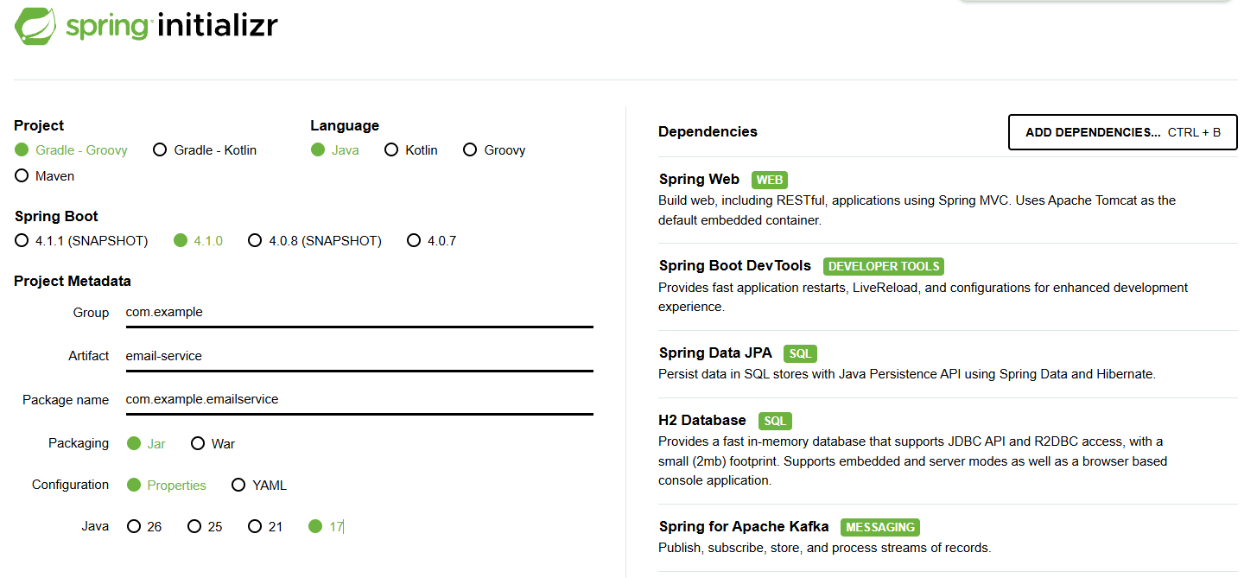
EmailService 애플리케이션 생성

Slide 12
EmailLog 엔티티 작성
@Entity
@Table(name = "email_logs")
public class EmailLog {
@Id @GeneratedValue(strategy = GenerationType.IDENTITY)
private Long id;
private Long receiverUserId;
private String receiverEmail;
private String subject;
public EmailLog() {}
public EmailLog(
Long receiverUserId,
String receiverEmail,
String subject
){
this.receiverUserId = receiverUserId;
this.receiverEmail = receiverEmail;
this.subject = subject;
}
public Long getId() {
return id;
}
public Long getReceiverUserId() {
return receiverUserId;
}
public String getReceiverEmail() {
return receiverEmail;
}
public String getSubject() {
return subject;
}
}

Slide 13
UserSendUpEvent 작성(Json Parsing객체)
public class UserSignedUpEvent {
private Long userId;
private String email;
private String name;
public UserSignedUpEvent() {
}
public UserSignedUpEvent(
Long id,
String email,
String name
) {
this.userId = id;
this.email = email;
this.name = name;
}
public Long getUserId() {
return userId;
}
public String getEmail() {
return email;
}
public String getName() {
return name;
}
public static UserSignedUpEvent fromJson(String json) {
ObjectMapper objectMapper = new ObjectMapper();
try {
return objectMapper.readValue(json, UserSignedUpEvent.class);
}catch(JacksonException e) {
e.printStackTrace();
throw new RuntimeException("Json 파싱 실패");
}
}
}

Slide 14
EmailLog 저장 EmailLogRepository 작성
public interface EmailLogRepository extends JpaRepository<EmailLog, Long> {
}

Slide 15
Kafka 메세지 처리(UserSignedUpEventConsumer) 작성
@Service
public class UserSignedUpEventConsumer {
private final EmailLogRepository emailLogRepository;
public UserSignedUpEventConsumer(EmailLogRepository emailLogRepository) {
this.emailLogRepository = emailLogRepository;
}
@KafkaListener(
topics = "user.signed-up",
groupId = "email-service",
concurrency = "3"
)
@RetryableTopic(
attempts = "3",
backOff = @BackOff(delay = 1000, multiplier = 2),
dltTopicSuffix = ".dlt"
)
public void consume(String message) throws InterruptedException {
UserSignedUpEvent userSignedUpEvent = UserSignedUpEvent.fromJson(message);
// 실제 이메일 발송 로직
String receiverEmail = userSignedUpEvent.getEmail();
String subject = userSignedUpEvent.getName() +" 님, 회원가입을 축하합니다.";
Thread.sleep(3000);
System.out.println("이메일 발송 완료");
//이메일 발송 로그 저장
EmailLog emailLog = new EmailLog(
userSignedUpEvent.getUserId(),
receiverEmail,
subject
);
emailLogRepository.save(emailLog);
}
}

Slide 16
Kafka 메세지 장애 대비(UserSignedUpEventDltConsumer) 작성
@Service
public class UserSignedUpEventDltConsumer {
@KafkaListener(
topics = "user.signed-up.dlt",
groupId = "email-service"
)
public void consume(String message) {
// 실제 로직은 생략
System.out.println("로그 시스템 발송");
System.out.println("Slack 알림 메시지");
}
}

Slide 17
CLI Kafka 서버 셋팅
1. kafka-topic 추가
producer: UserService.java signUp
user.signed-up 메세지 처리 실패시 저장 dlt
~ Kafka폴더 > bin/kafka-topics.sh --bootstrap-server localhost:9092 --create --topic user.signed-up --partitions 3 --replication-factor 3
~Kafka폴더 > bin/kafka-topics.sh --bootstrap-server localhost:9092 --create --topic user.signed-up.dlt --partitions 1 --replication-factor 3
topic 생성 확인
~Kafka폴더 > bin/kafka-topics.sh --bootstrap-server localhost:9092 --describe --topic user.signed-up
~Kafka폴더 > bin/kafka-topics.sh --bootstrap-server localhost:9092 --describe --topic user.signed-up.dlt

Slide 18
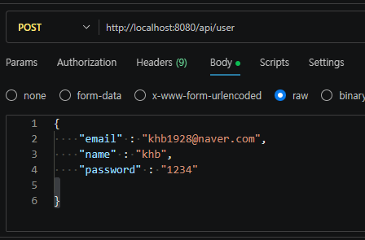
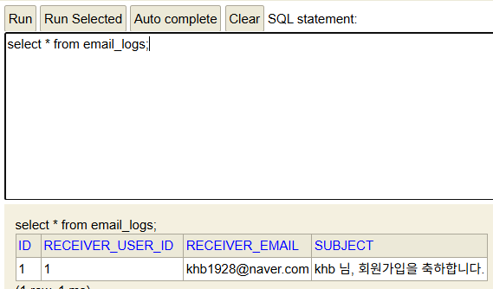
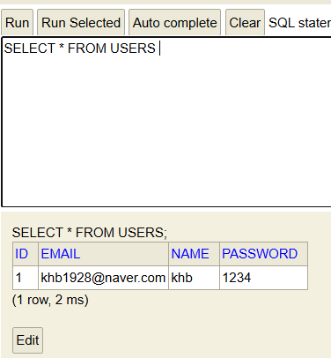

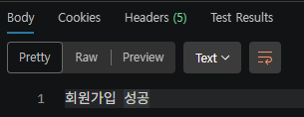
kafka 회원가입 -이메일 발송 테스트
8081포트
8080포트

